Slide 1
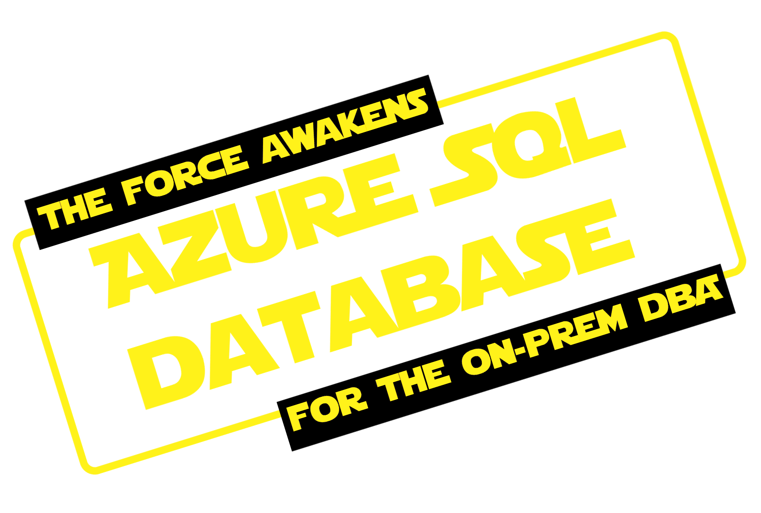

2019
Artificial Edition
6-8 February
Alexander Arvidsson
@arcticdba

Slide 2



Copyright (C)Lucasfilm/Disney All Rights Reserved

Slide 3
Overview of AZURE SQL SERVER
Look at things to KEEP IN MIND
Ask the HARD QUESTIONS

Slide 4
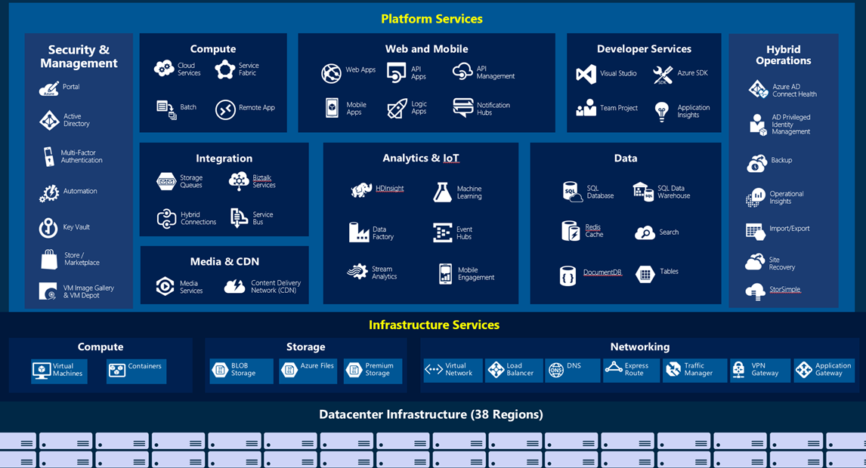

Slide 5


Slide 6

Copyright (C)Lucasfilm/Disney All Rights Reserved

Slide 7




Principal Solutions Architect @ Atea
| Data Platform MVP | Speaker | Blogger |
| Podcaster | Pluralsight author |

Slide 10




Slide 11
Lift-and-shift workloads
Specific compatibility requirements
Minimal hands-on requirements
New cloud-designed applications
Short time-to-market
Minimal to zero hands-on requirements
New cloud-designed applications
Multi-tenant load patterns
Minimal to zero hands-on requirements

Slide 12
Lift-and-shift workloads
Specific compatibility requirements
Minimal hands-on requirements
New cloud-designed applications
Short time-to-market
Minimal to zero hands-on requirements
New cloud-designed applications
Multi-tenant load patterns
Minimal to zero hands-on requirements

Slide 13
Lift-and-shift workloads
Specific compatibility requirements
Minimal hands-on requirements
New cloud-designed applications
Short time-to-market
Minimal to zero hands-on requirements
New cloud-designed applications
Multi-tenant load patterns
Minimal to zero hands-on requirements

Slide 14
DMV & XEvents
SQL Agent(*)
CLR
Native backup/restore
Cross-database queries

Slide 15
Entirely independent
Elastic database jobs
Little or no administration
Automatic tuning
Simple, fast scaling

Slide 16
Multi-tenant load patterns
Simple move in – move out

Slide 17
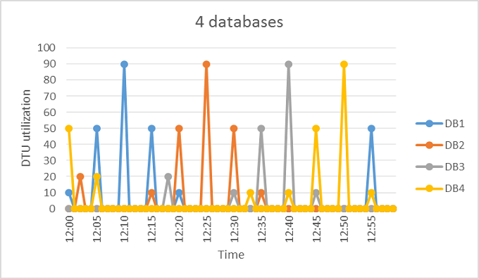

Slide 18
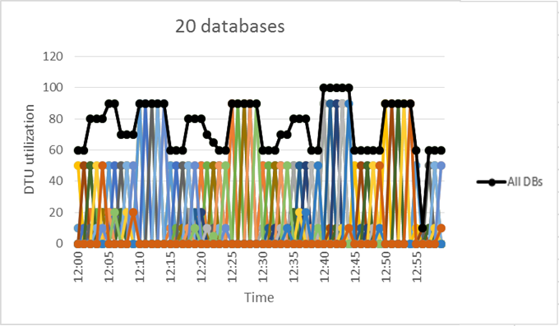

Slide 19

Copyright (C)Lucasfilm/Disney All Rights Reserved

Slide 20
vCore
vCore
vCore
DTU
eDTU

Slide 21





General
Purpose
Business
Critical
1-80 vCPU
44-440GB
Max 8TB | 4TB*
~500-7500 / file | 1375 / vCore
5-10ms | 1-2ms

Slide 22
General
Purpose
Business
Critical
Hyperscale
(preview)
1-80 vCPU
7/5.1 GB / vCore
5TB | 1TB | 100TB+
500 IOPS /vCore (max 5000) | 5000 IOPS /vCore (max 200.000) | TBD

Slide 23
Standard
Premium
Basic
S0 – 10 DTU
…
S12 – 3000 DTU
P1 – 125 DTU
…
P15 – 4000 DTU
B – 5 DTU

Slide 24
Basic
Standard
Premium
50-1600 eDTU
50-3000 eDTU
125-4000 eDTU

Slide 25
800x
5 DTU
4000
DTU

Slide 26

DTU
vCore

Slide 27

DTU
vCore
Copyright (C)Lucasfilm/Disney All Rights Reserved

Slide 28
Migration
Installation
Performance monitoring
Maintainance
Configuration
Capacity planning
High availability
Upgrade
Trouble-shooting
Backup / recovery

Slide 29
Installation
Performance monitoring
Trouble-shooting
High availability
Configuration
Backup / recovery
Capacity planning
Migration
Maintainance
Upgrade

Slide 30
Installation
Performance monitoring
Trouble-shooting
High availability
Configuration
Backup / recovery
Capacity planning
Migration
Maintainance
Upgrade

Slide 31
Backup / recovery
High availability

Slide 32
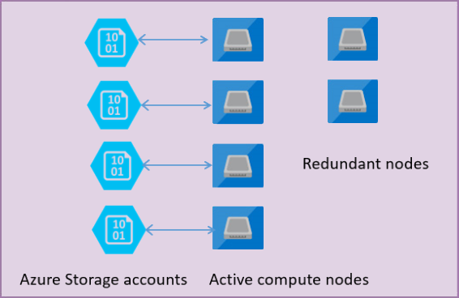

Slide 33
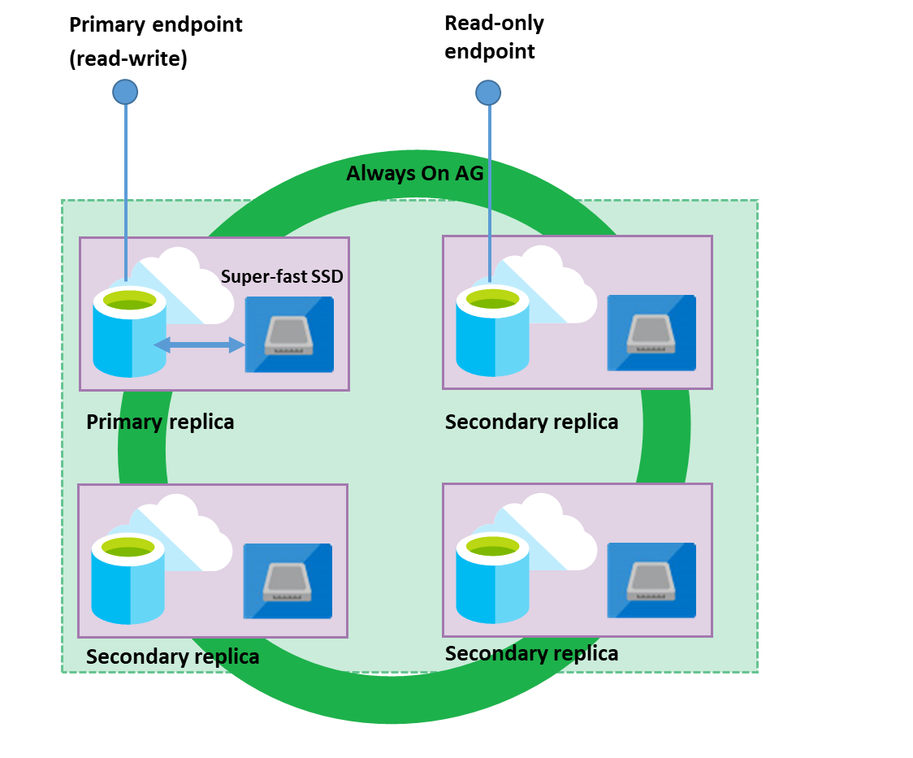

Slide 34
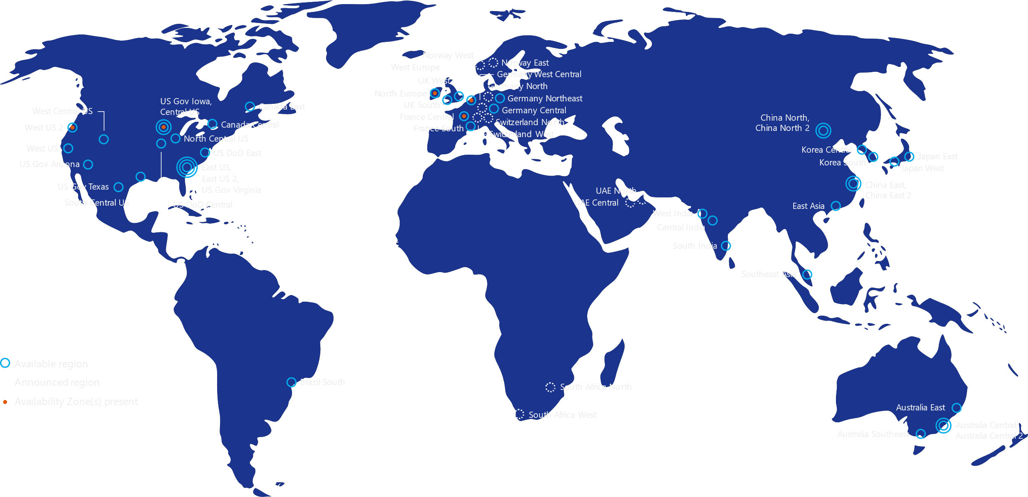

Slide 35
Performance monitoring
Trouble-shooting

Slide 36
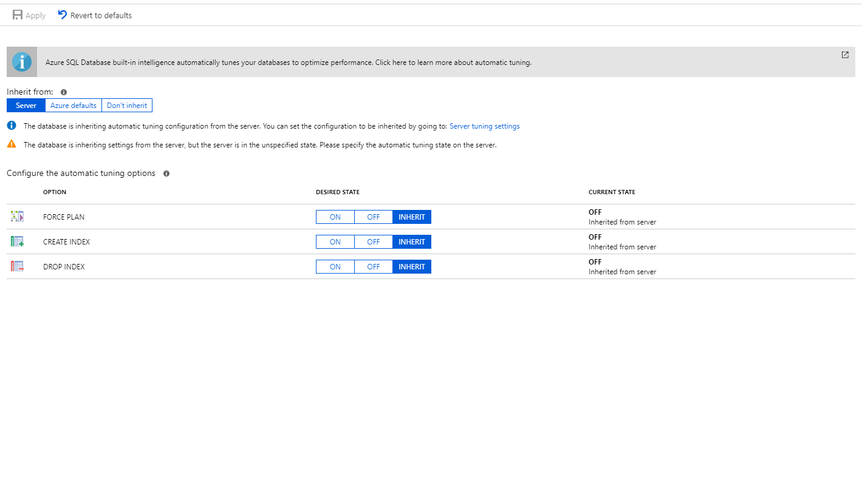

Slide 37
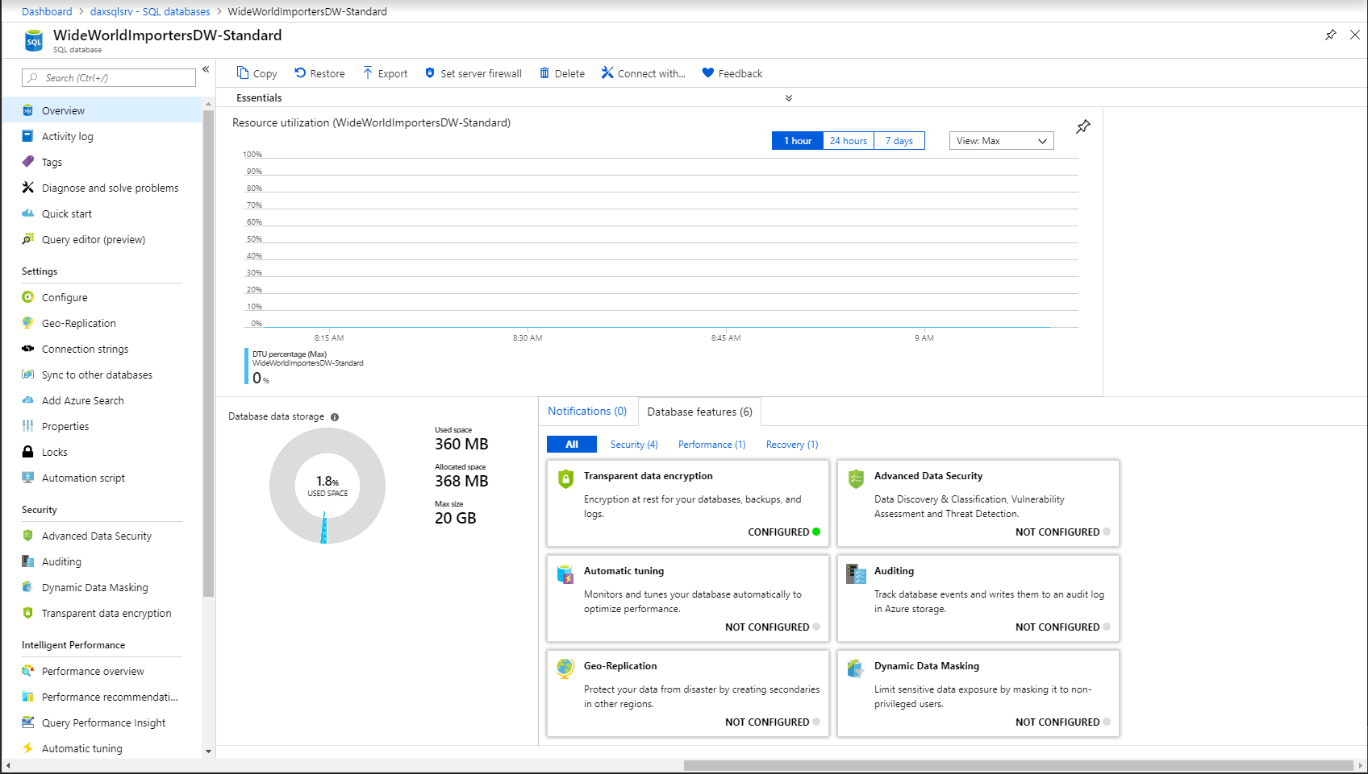

Slide 38
Maintainance

Slide 39
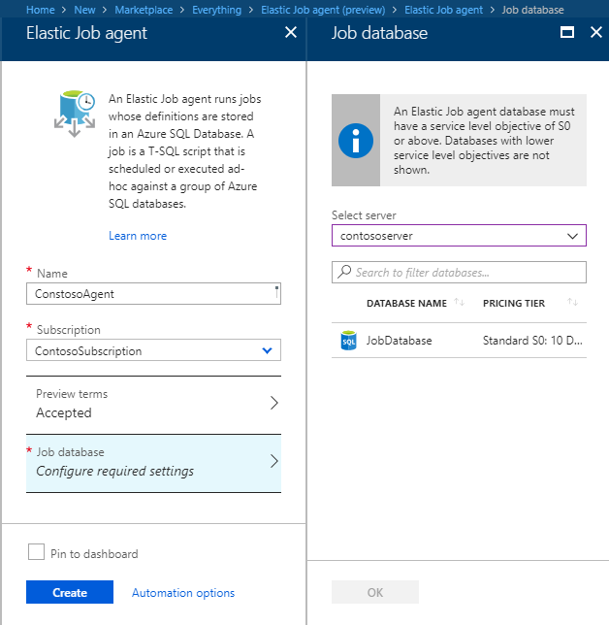
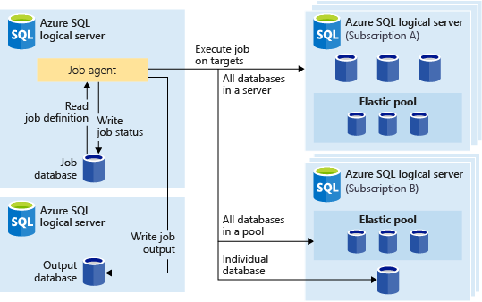

Slide 40
Capacity planning

Slide 41
Migration

Slide 42
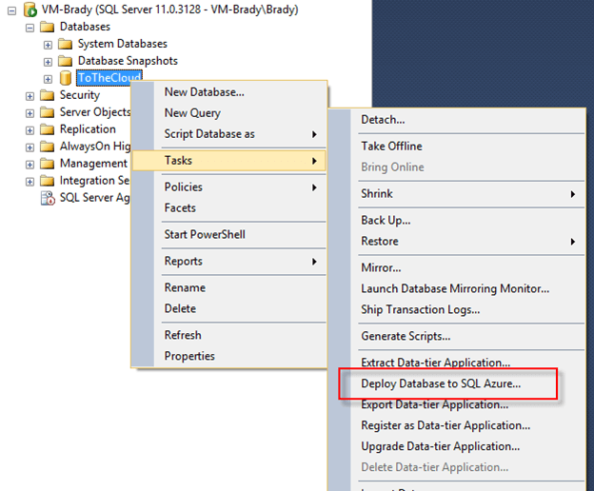


Slide 43
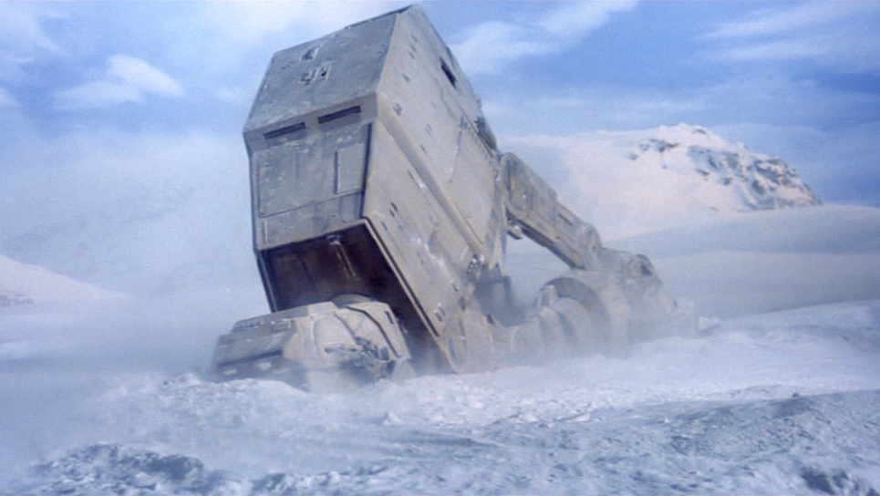

Copyright (C)Lucasfilm/Disney All Rights Reserved

Slide 44



Slide 45

NOT SO GOOD
things with
Azure SQL Server
Copyright (C)Lucasfilm/Disney All Rights Reserved

Slide 46
Price
Performance
Often requires redesign
Latency
Featureset
Automation

Slide 47

GOOD, GOOD
things with
Azure SQL Server
Copyright (C)Lucasfilm/Disney All Rights Reserved

Slide 48
Elasticity
Simplified administration
Automation
No upfront costs
Integration
High availability

Slide 49
Are you ASKING the
right QUESTIONS?

Slide 50
ASSUMPTION
Is the mother of all
SCREWUPS

Slide 51
Capitalize on the
OPPORTUNITIES

Slide 52

?
?

Slide 53
Azure SQL Server is A TOOL, not necessarily THE TOOL
Learn the NEW WAYS
Ask the HARD QUESTIONS
you must

Slide 54

Copyright (C)Lucasfilm/Disney All Rights Reserved

Slide 55

Copyright (C)Lucasfilm/Disney All Rights Reserved
Copyright (C)Lucasfilm All Rights Reserved

Slide 56




Thank you!
https://www.arcticdba.se
@arcticdba
alexander@arcticdba.se
Knee-Deep in Tech

Slide 57
Slides and demos from the conference will be available at
https://github.com/nordicinfrastructureconference/2019

